Slide 1
Ternary Volatile Random Access Memory based on Heterogeneous Graphene-CMOS Fabric
- Santosh Khasanvis, K. M. Masum Habib*, Mostafizur Rahman, Pritish Narayanan, Roger K. Lake* and Csaba Andras Moritz
University of Massachusetts Amherst
*University of California Riverside

Slide 2
Outline
Motivation
Bi-Layer xGNR Device, Latch
Proposed Memory Cell - Ternary GNTRAM
Evaluation and Comparison with CMOS SRAM
Summary

Slide 3
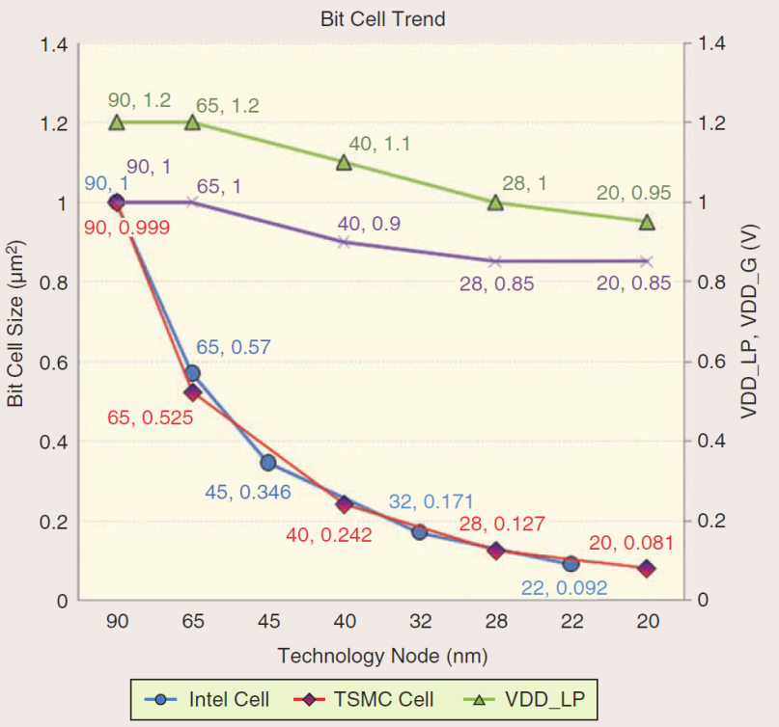
Multistate Memory: Motivation & Vision
SRAM Area Trends
Challenges with CMOS SRAM
Slowdown in area scaling (50% down to 30% per generation)
Increasing leakage concerns
SRAM Cell Size
Concept
Binary Memory Array
Multistate Memory Array
Source: 2012 ISSCC Tech Trends
Vision – New multi-bit per cell volatile memory with graphene
Current: Single bit/cell
Proposed: Multi-bit/cell with novel graphene structures

Slide 4
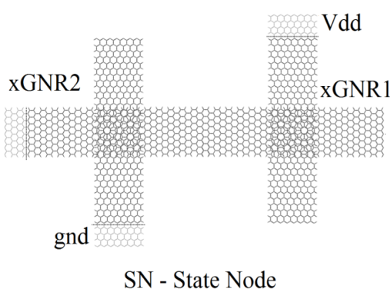
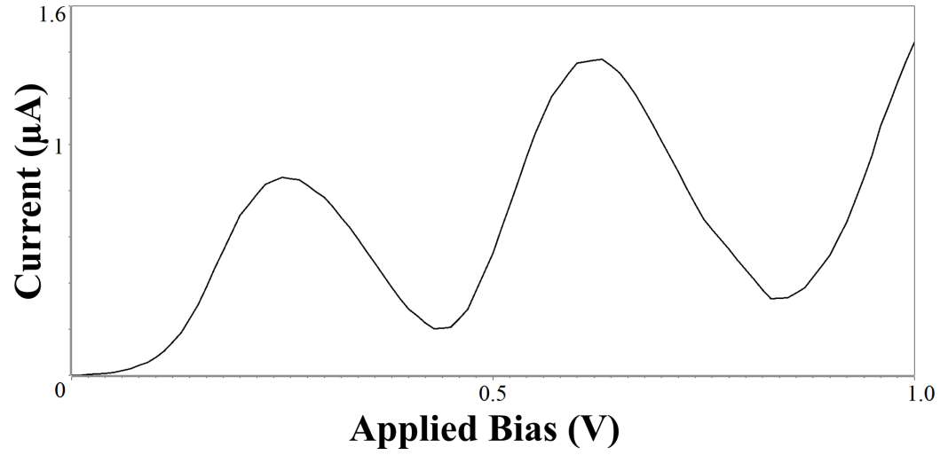
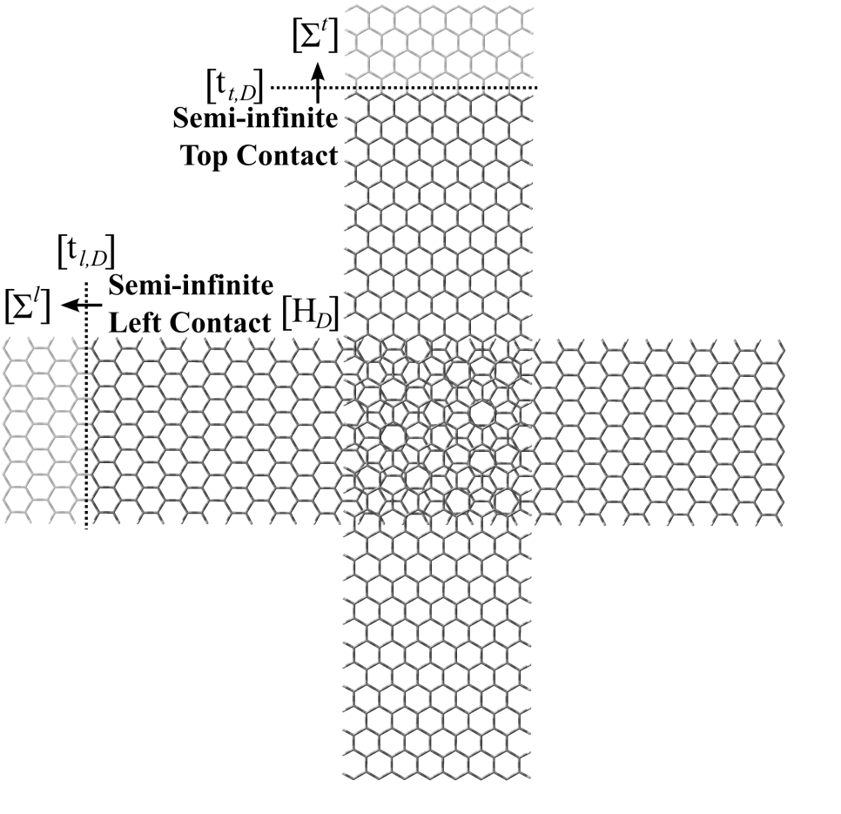
Bi-Layer Graphene Nanoribbon Crossbar Device (xGNR) & Application
DC Characteristics
Latch Configuration
A
Vdd
SN
B
DC Load Line Analysis
Unstable
Graphene Nanoribbon Crossbar Resonant Tunneling Diode - K. M. M. Habib and R. K. Lake, University of California Riverside
Armchair Graphene Nano-Ribbons arranged in a crossbar geometry (xGNR) exhibit Negative Differential Resistance (NDR)
Stable
xGNRs in series form a latch with multiple stable states (A, B & C)
Ternary data represented by state node (SN) voltage: A—Logic 0, B—Logic 1, & C—Logic 2

Slide 5
Graphene Nanoribbon Tunneling RAM (GNTRAM)
xGNR Latch
Memory Circuit
Proposed Memory Cell
xGNR latch forms the memory core of a RAM cell
Memory cell selection, read and write operations performed using access transistors
Schottky diode and Sleep FET mitigate stand-by power consumption

Slide 6
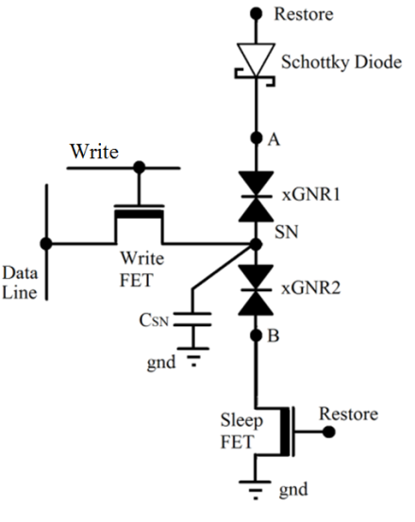
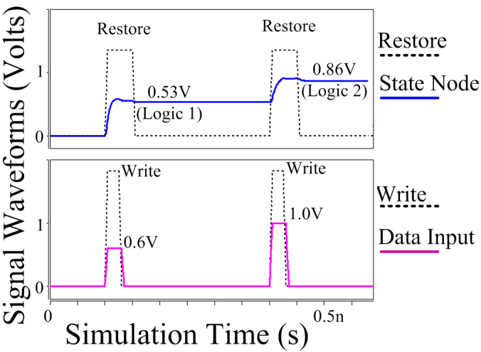
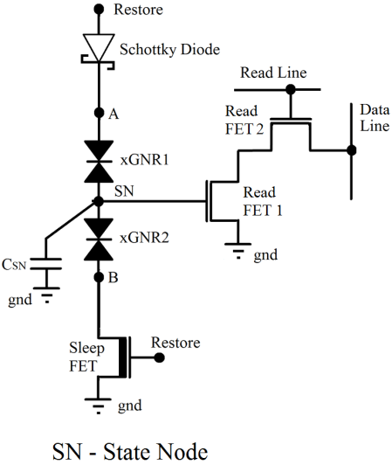
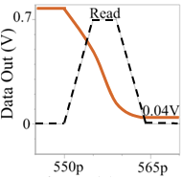
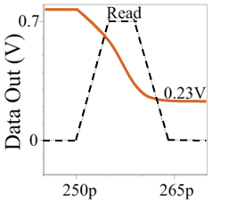
Ternary GNTRAM Operation
Write Operation:
Ternary data represented by state node (SN) voltage
Apply input voltage on ‘Data Line’ & assert ‘Write’ signal
Charge/discharge state node to required voltage
Read Operation:
Pre-charge ‘Data Line’ & apply ‘Read’ pulse
Output is pulled down based on stored logic state
Non-destructive read
Write Operation
State Node
Input
Voltage
Input
Read Operation
SN: Logic 2
SN: Logic 1
Output
Simulation Time (s)
Data Out
Read

Slide 7
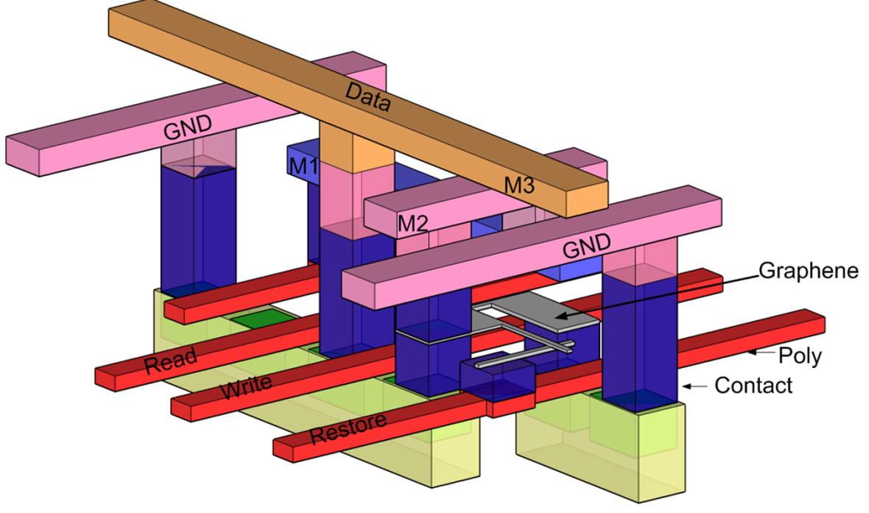
Proposed Physical Implementation – Integration with CMOS
Si MOSFETs
Heterogeneous integration between CMOS and Graphene for validation and benchmarking
MOS transistors and metal layers for access and routing
Schottky contact* enabled by interaction between semiconducting GNR and metal
*X. Guan; et al.; , "Modeling of schottky and ohmic contacts between metal and graphene nanoribbons using extended hückel theory (EHT)-based NEGF method,“ IEDM 2008.

Slide 8
Methodology & Benchmarking
HSPICE simulation for concept validation, performance and power evaluation
16nm Grid-based design rules used to evaluate GNTRAM area
16nm Design Rules
C. Bencher, et al.. “Gridded design rule scaling: Taking the CPU toward the 16nm node”, Proc. SPIE 7274, 2009
Comparison with 16nm High Performance (HP) CMOS SRAM
 | GNT RAM (Per Cell, 1.585 bits) | GNT RAM (Per Bit) | CMOS 6T Scaled SRAM Cell | CMOS Gridded 8T SRAM Cell
RAM Cell Area (µm²) | 0.03-0.06 | 0.019-0.038 | 0.026-0.064 | 0.034-0.067
Active Power (µW) | 2.1 | 1.31 | 2.1 | 2.41
Standby Power (pW) | 22 | 13.9 | 6152 | 15552
Performance | GNT RAM | CMOS 6T Scaled SRAM Cell | CMOS Gridded 8T SRAM Cell
Read Time (ps) | 9.3 | 8.8 | 7.7
Write Time (ps) | 16.3 | 18.4 | 18
Density Benefit (per bit) : Upto 1.77x vs. SRAMs
Power Savings (per bit): Upto 1.84x (Active) and 1196x (Leakage) vs. HP SRAMs
Performance: Comparable to HP CMOS SRAMs

Slide 9
Summary
Novel ternary memory (1.5 bits/cell) presented with heterogeneous CMOS-Graphene implementation
Density and power benefits vs. 16nm CMOS SRAMs with comparable performance
Next Steps: Increasing number of states/cell – a new dimension for scaling
Possibility of all-graphene fabrics as graphene technology matures
Thank You!
Acknowledgements: Collaboration with Prof. Roger Lake, UC Riverside
Sponsors:

